Slide 1
Creating your vision… a leadership journey
Donna M. Carroll
VP for Operational Excellence

Slide 2
Workshop Overview
This workshop will provide you with an introductory discussion on the concepts of
Leadership & Vision…
the rest is up to you!

Slide 3
Leadership basics
Leadership
The art of instilling in people the attitudes and feelings that they can and will accomplish objectives that enhance their personal and professional lives.
(A.S. Migs Damiani)

Slide 4
Why do we need Leadership?
“The Truth is that no one factor makes a company admirable. But if you were forced to pick the one that makes the most difference, you‘d pick leadership.”
(Warren Bennis, 1998)

Slide 5
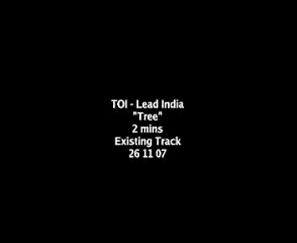
Leadership/Management
“The act of Leadership occurs any time one attempts to influence the behavior of an individual or group, regardless of the reason. . . .
Management is a kind of leadership in which the achievement of organizational goals is paramount." (Hersey, P. and Blanchard, K. : 1982)
(JOB AID 19.1)

Slide 6
Where do Leaders come from?
Nature: Trait Theory
Agreeableness
Extroversion*
Conscientiousness*
Emotional Stability*
Openness to Experience
Nurture: Learning Theory
Situational: Contingency Theory

Slide 7
Power Bases
Leadership is power by influence.
Management is power by position.

Slide 8
What’s your style?
Leadership Self Assessment

Slide 9
Scoring
Style of leadership from left to right on the scoring sheet
Authoritarian Style
Participative Style (Democratic)
Delegative Style (Laissez Faire)
The lowest score possible for any stage is 10 (Almost never) while the highest score possible for any stage is 50 (Almost always).

Slide 10
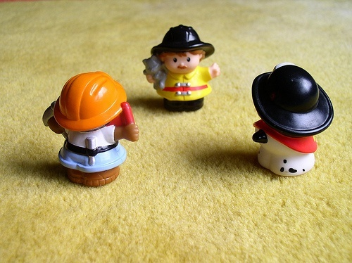
Leadership Styles
AUTOCRATIC : dominates team-members, using unilateralism to achieve a singular objective.
This style is used when leaders tell their employees what they want done and how they want it accomplished, without getting the advice of their followers. Some of the appropriate conditions to use it is when you have all the information
to solve the problem, you are short on time, and your employees are well motivated.
I want you guys to….

Slide 11
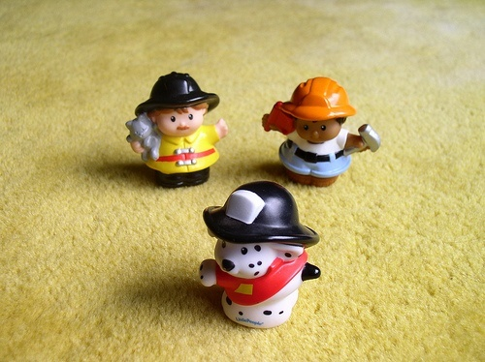
Leadership Styles
Laissez-Faire : exercises little control over his group, leaving them to sort out their roles and tackle their work.
In this style, the leader allows the employees to make the decisions.
However, the leader is still responsible for the decisions that are made.
This is used when employees are able to analyze the situation and determine what needs to be done and how to do it. You cannot do everything!
You must set priorities and delegate certain tasks.
You two take care of the problem while I go. . .

Slide 12
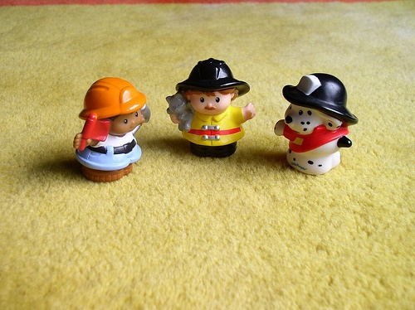
Leadership Styles
Democratic : makes decisions by consulting his team, while still maintaining control of the group
This style involves the leader including one or more employees in the decision making process
(determining what to do and how to do it).
However, the leader maintains the final decision making authority.
Using this style is not a sign of weakness, rather it is a sign of strength that your employees will respect.
Let's work together to solve this. . .

Slide 13
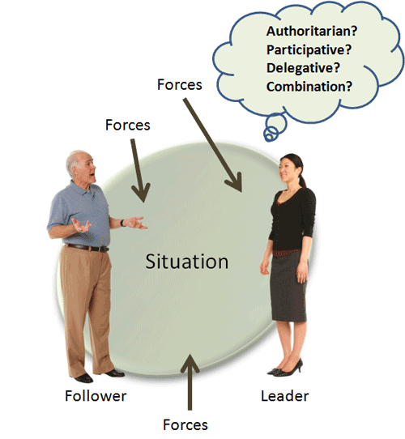
What leadership style works best?
The answer is all of them. Leaders function best when they are able to flow from one style to the next depending on the skills sets of the follower and the forces impacting on the situation.

Slide 14
Contemporary Issues of Leadership Effectiveness
Emotional Intelligence: Daniel Goleman
Five Key Components
Self-awareness
Self-management
Self-motivation
Empathy
Social Skills
Ethical Leadership: John Maxwell
Leadership is not value-free
More focus on how leaders achieve their goals
Cross-Cultural Leadership: Bill Gates
The world is getting smaller
Leaders must adapt their style to different cultures

Slide 15
The Two Most Important Keys to Effective Leadership
Cultivating Trust and Confidence
Fostering Effective Communication

Slide 16
Trust, Teams & Leadership What is trust?
Trust: is the positive expectation that another will not through words, actions or decisions, act opportunistically.
Builds and accumulates in stages
Requires vulnerability
Takes time to form
Five key dimensions
Integrity
Competence
Consistency
Loyalty
Openness

Slide 17
Establishing Trust
Know your values.
Be trust worthy.
Hurley’s Model of Trust
How do you build trust?
Practice openness
Be fair
Speak your feelings
Tell the truth
Show consistency
Fulfill your promises
Maintain confidences
Demonstrate competence

Slide 18
How did you get here? What’s your story?
Understanding what brought you to where you are as a leader is part of your story. Awareness and authenticity are attributes that are vital to good leader’s.

Slide 19
Time for a Break
Take 10

Slide 20
VISION

Slide 21
Starting point
All journey’s require a starting point and
destination. The questions leaders must ask
themselves when constructing their vision
are:
Were am I now?
How did I get here?
What is my purpose?
What drives me?
Are my actions inline with my purpose
and drive?
How can my being here make a difference?

Slide 22
What is Vision
A vision is a picture of the new “world” a leader wishes to create. It is a picture into which the leader fits an understanding of why people will be better off, the source of the new value that will be created, and the relationships that will exist.
Vision ascends from two deep human needs: quality and dedication and engages the heart and the spirit
Warren Bennis

Slide 23
Vision is the natural manifestation of…. discontent
A vision develops from the idea that things might be different from, and better than, they are currently.
Vision exists in the tension between what is and what might be. It is the bridge that links the now and the could be.

Slide 24
Pioneer Leadership- Frustrations Equals Vision!
How the process works…..

Slide 25
Getting your message out
A manager’s vision is something that he can convey to his employees and then show them through his actions and his focus. It can be his greatest asset, or it can be the destruction of his reputation if he fails to keep a constant vigilance in making his vision happen. Phil Gerbyshak
How not to share your vision

Slide 26
THE POWER OF LEADING WITH VISION

Slide 27
How to Define the Preferred Future
Start with your aspirations. What are your aspirations? Is there some particular concept, process, or product that you wish to develop?
Do your research. Compare your ideas with others in your field by studying books, trade magazines, and Web sites. Talk about your ideas with your personal board of directors or mastermind group.
Spend some time thinking about your organization and its component parts. What could you do to improve the organization? What is the single biggest hurdle to success in your unit or the organization as a whole?

Slide 28
How to Define the Preferred Future cont.
Think about potential improvements. What can you do to improve the organization or component? Think about both the short term and the long term. This will enable you to set short-term and long-term goals to take steps toward realizing your vision.
Think about do-ability. Are your goals realistic? If your vision points to goals that seem unattainable, is there a way to break down the vision into a simpler form?
Use your intuition. Does your vision make sense? Can you explain it to a child?
Phil Gerbyshak

Slide 29
What’s stopping you?
What traits, attributes, skills or characteristics do you believe are required before you become visionary leader?
VISION

Slide 30
Building Confidence in Your Vision
Confidence in yourself will be bolstered by both positive thinking and by the process of formulating your vision.
Self-confidence frequently tends to be the result of the measurable success of your actions, and is ultimately up to you.
To build your self-confidence, you might make a list of your assets and past successes, no matter how small they were.

Slide 31
CREATE YOUR
VISION
NOT EXCUSES

Slide 32
My challenge to you
Complete the self-assessment package provided to you in this workshop
Discuss what you’ve learned about yourself with whomever you trust
Develop your vision statement
Be bold and share your vision with at least one person… that person could even be me.
My door is always open bring your vision and I promise to listen.

Slide 33
Closing thoughts
Finally, sharing your vision with others, be it your team or your superiors, is an important aspect of building confidence in your vision.
By sharing your vision with your team, you’ll let them know they have a leader who is thinking of the organization’s future, as well as theirs.

Slide 34
Suggested Readings
John C. Maxwell: The 21 irrefutable laws of leadership : follow them and people will follow you.
John C. Maxwell : Leadership 101/ What Every Leader Needs to Know.
David Cottrell :Monday Morning Leadership: 8 Mentoring Sessions You Can't Afford to Miss
Jim Underwood : More Than a Pink Cadillac : Mary Kay, Inc.'s Nine Leadership Keys to Success
Patrick M. Lencioni :The Five Dysfunctions of a Team:
A Leadership Fable
John C. Maxwell: Thinking for a change
Leo Buscaglia : Living, Loving & Learning and Personhood
A. S. Migs Damiani : Creative Leadership: Mining the gold
your workforce
Warren Bennis: On Becoming A Leader

